Slide 1
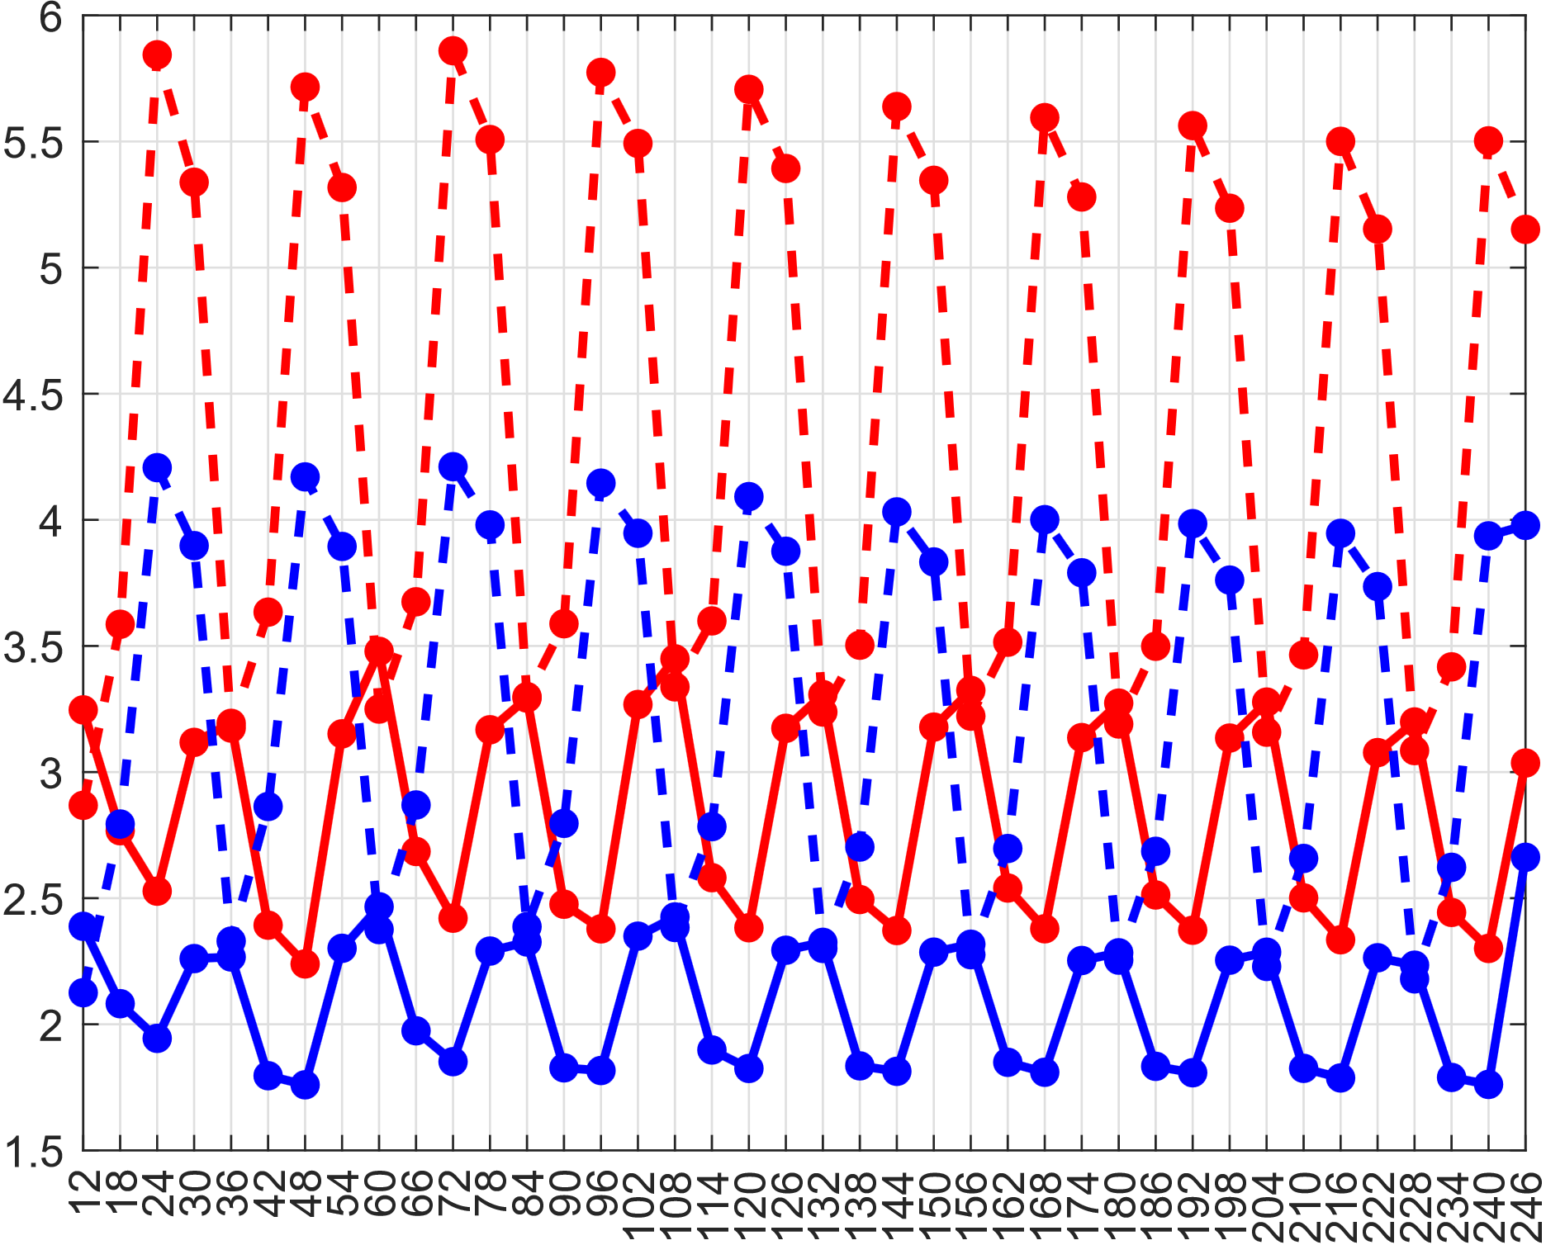
6 pm - 6 am
0 am – 12 am
6 am - 6 pm
12 am - 0 am

